Slide 1
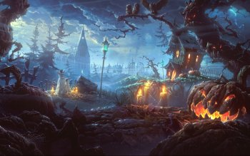

Happy Halloween

Slide 2


Halloween is on

Slide 3


COLORS

Slide 4
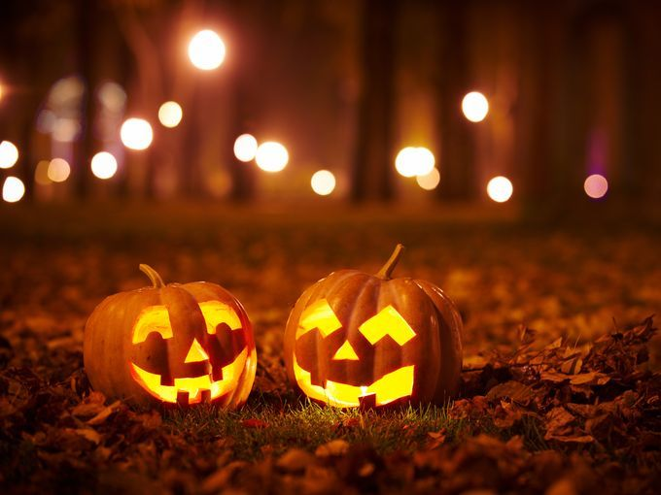
Pumkin(Jack o’ lantern)

Slide 5

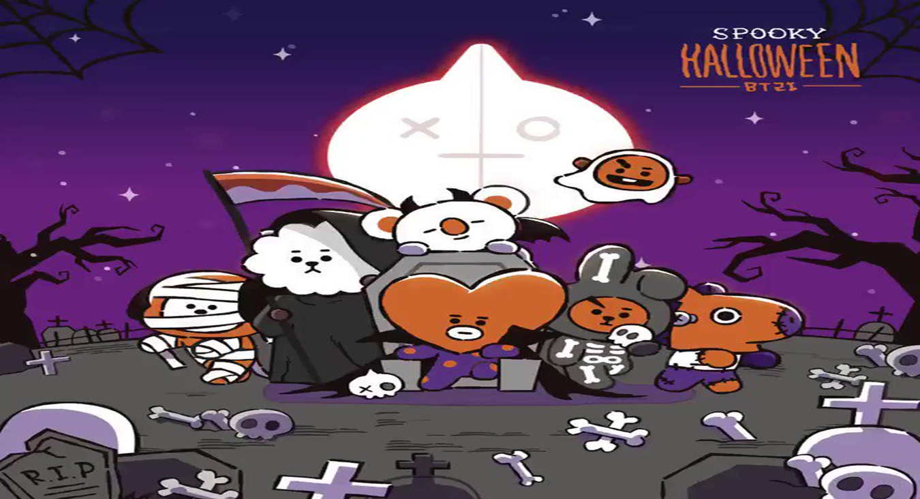
Halloween characters

Slide 6
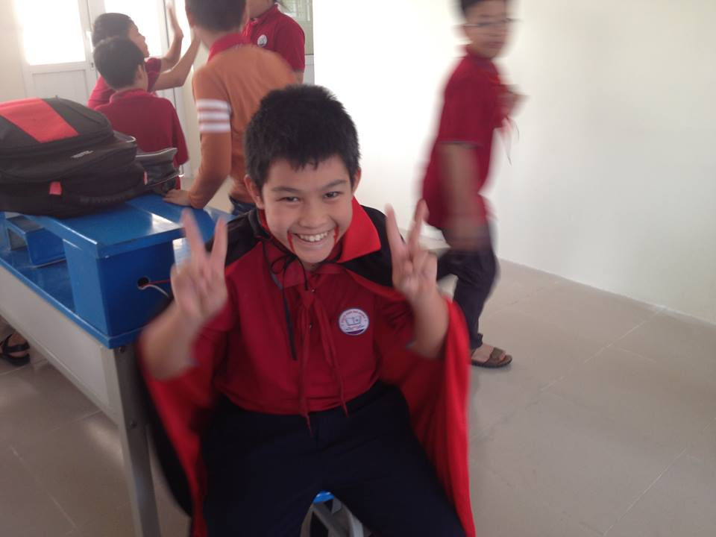
VAMPIRE

Slide 7

PIRATE

Slide 8
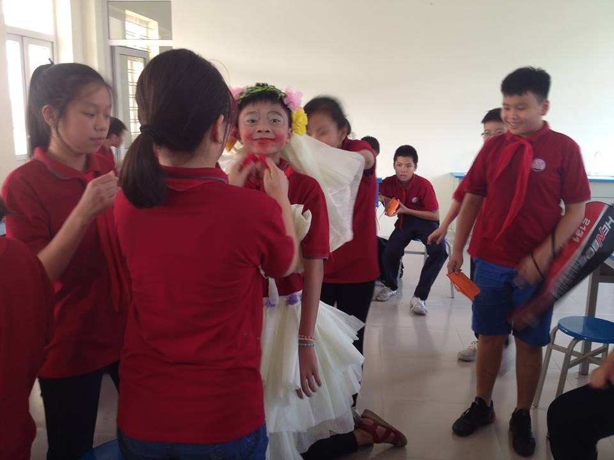
ghost bride

Slide 9


Slide 10
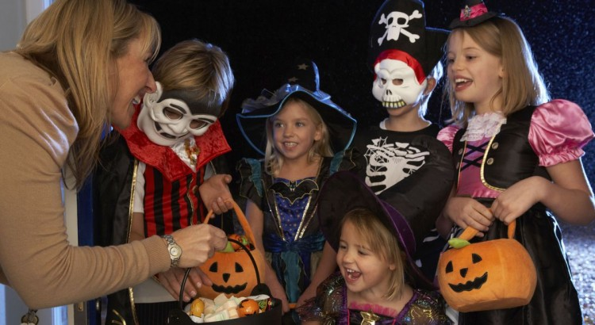
Trick or treat

Slide 11
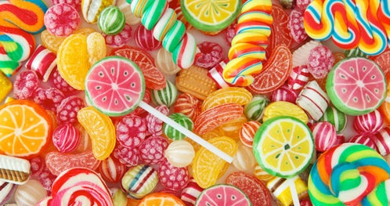
Sweet

Slide 12
Some food on Haloween

Slide 13
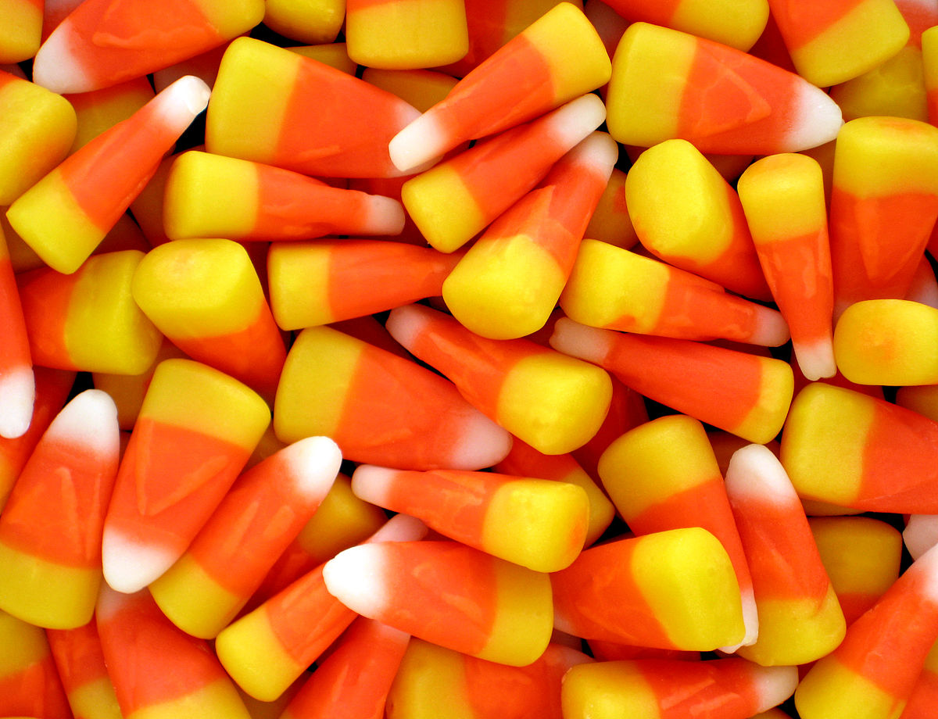
CANDY CORN

Slide 14
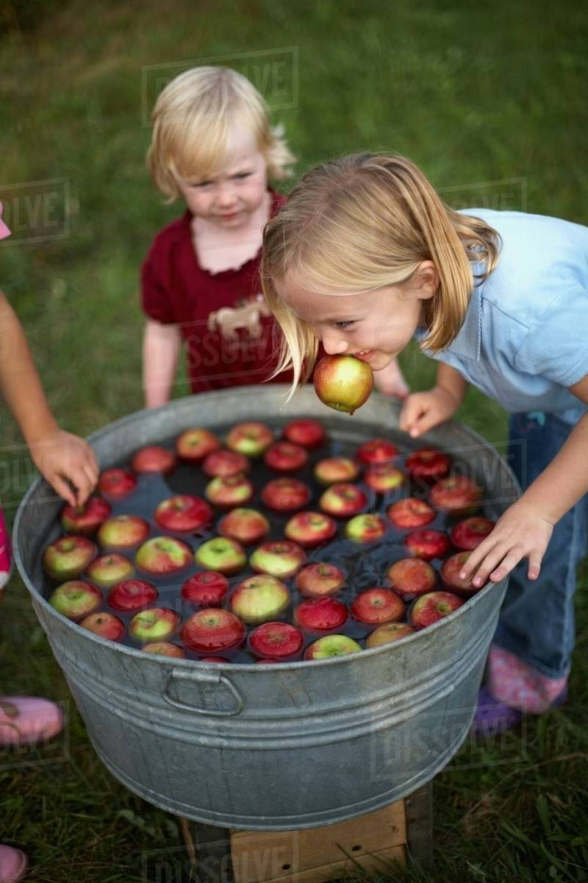
Apple bobbing

Slide 15
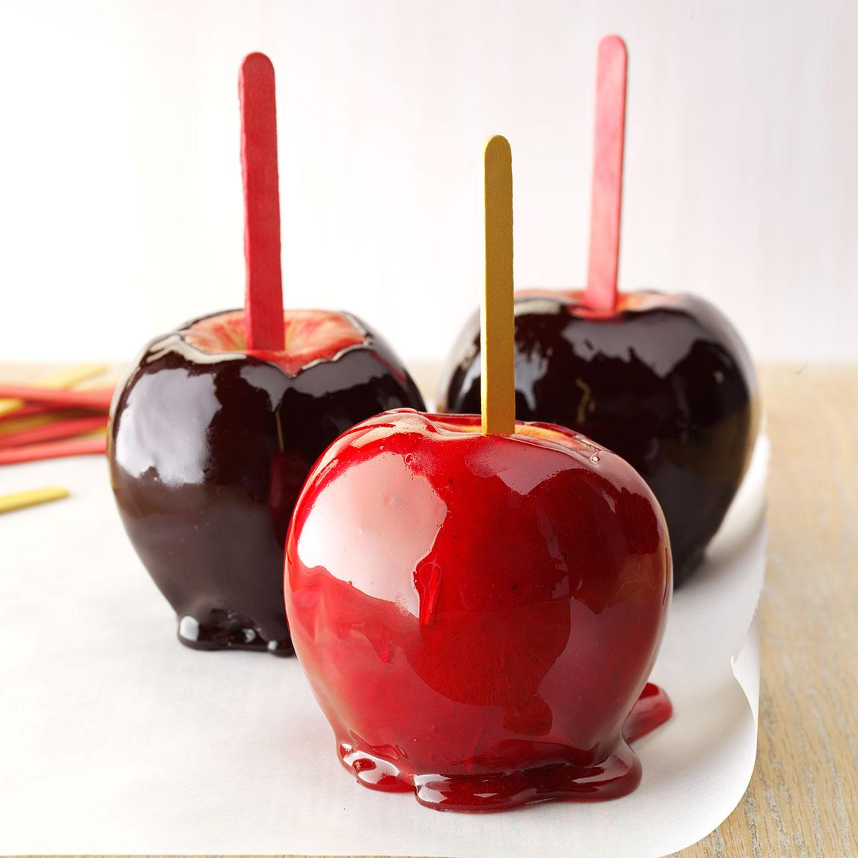
APPLE CANDY

Slide 16
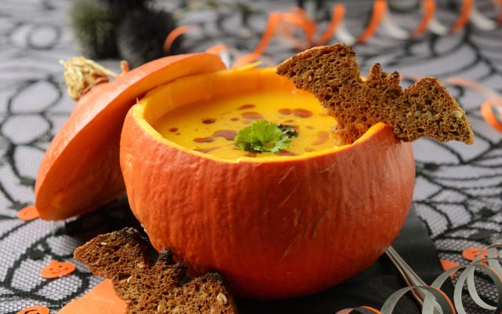
PUMKIN SOUP

Slide 17
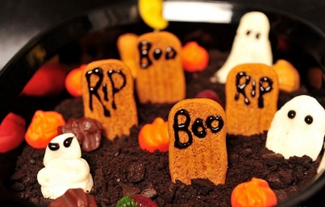
CEMETERY PUDING

Slide 18
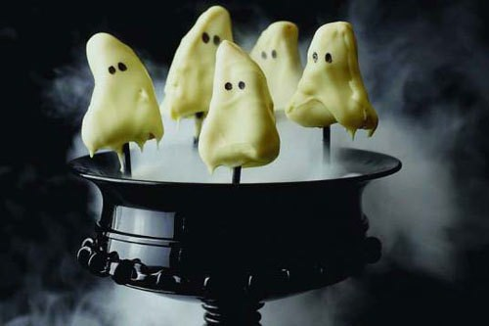
LEMON CAKE

Slide 19
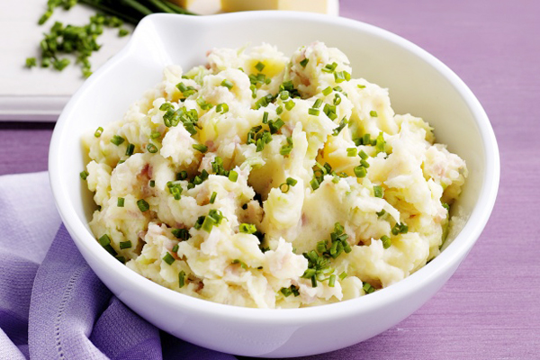
COLCANNON

Slide 20
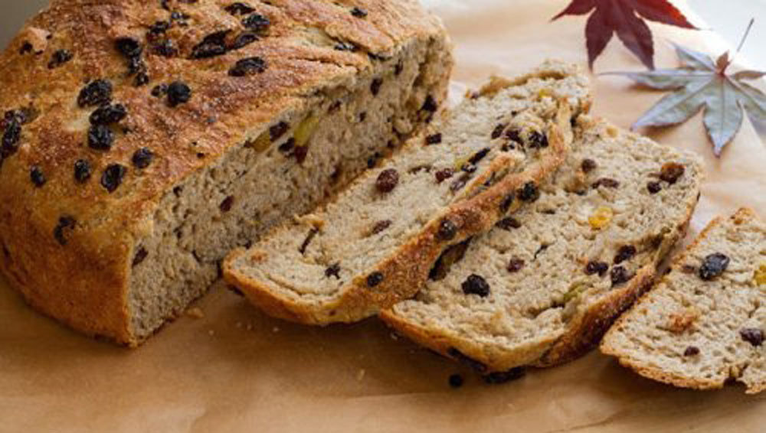
BARNBRACK

Slide 21
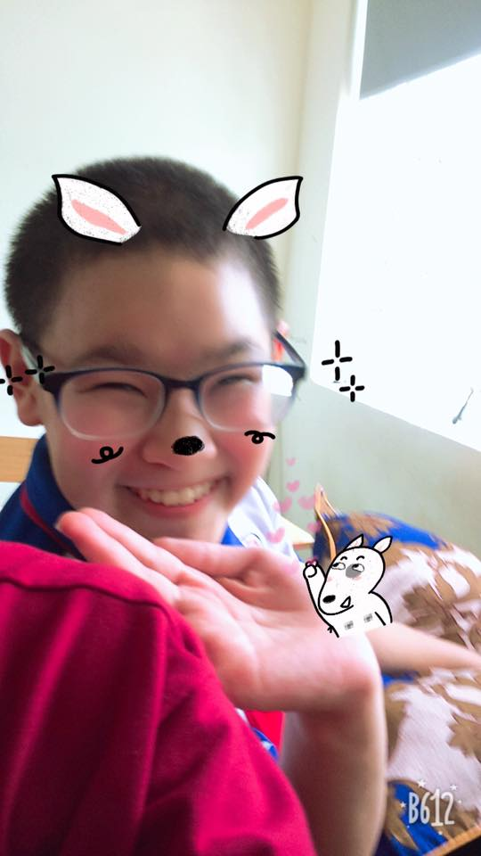
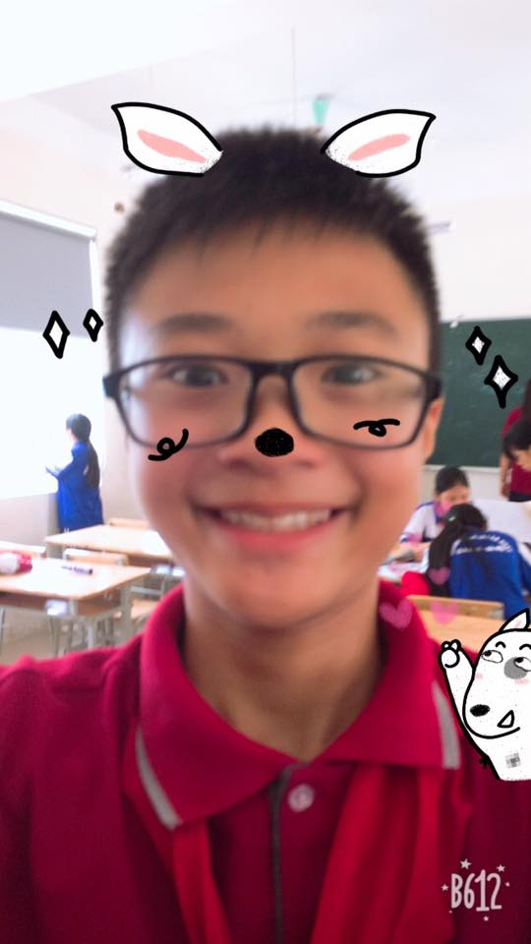
FUN~~~~

Slide 22

Scare TT

Slide 23
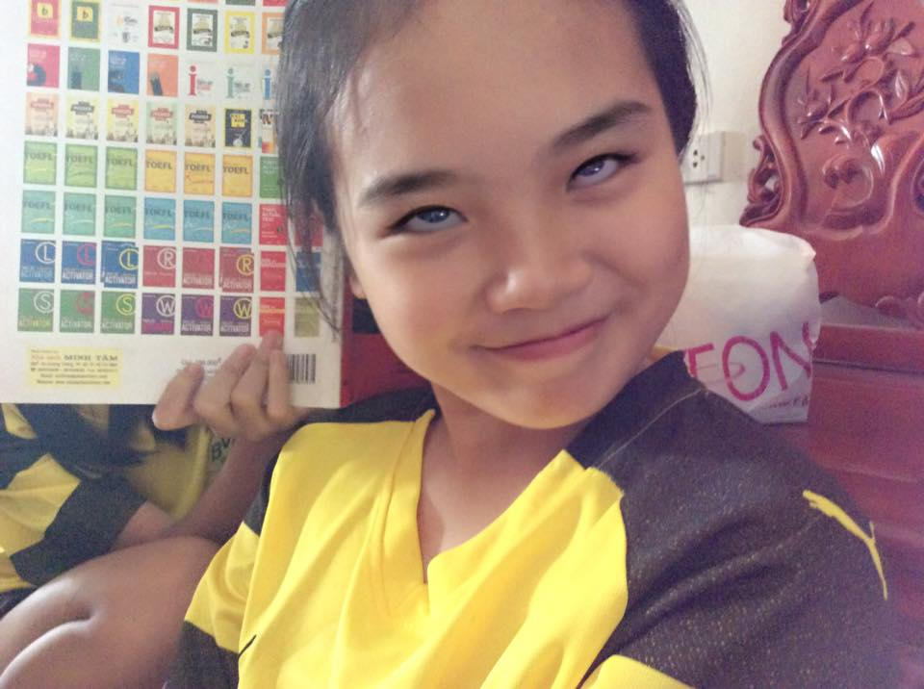
Enjoy halloween in ur own ways <3

